Slide 1
Module 3: Individual Peacekeeping Personnel
Lesson
3.8
Health

Slide 2
Relevance
To work effectively for others you need to be healthy
You may be exposed to health threats
UN Core Pre-Deployment Training Materials 2017

Slide 3
Learning Outcomes
Learners will:
List general health threats
List key factors determining level of risk to health
Describe precautions before travel to and in mission
Describe environmental health threats and precautions
UN Core Pre-Deployment Training Materials 2017

Slide 4
Lesson Overview
Health Threats
Determining Risks
Researching Information
Taking Precautions
Environmental Health Threats & Precautions
UN Core Pre-Deployment Training Materials 2017

Slide 5
Learning Activity
3.8.1
Determining Health Threats
Instructions:
Think about your deployment to the mission
Consider the destination, duration of assignment, type of work and your medical history
How might these affect your health?
What precautions should you take?
Time: 10 minutes
Group work: 5-7 minutes
Discussion: 3 minutes
UN Core Pre-Deployment Training Materials 2017

Slide 6
1. Health Threats
Unfamiliar environments and conditions
Exposure to insects, rodents, other animals
Infectious agents
Contaminated food and water
Poor hygiene
Emotionally charged, mentally intense, stressful situations
Fatigue
Communicable diseases
UN Core Pre-Deployment Training Materials 2017

Slide 7
Communicable diseases
Contact transmission diseases
Food-borne and water-borne diseases
Vector-borne diseases
Sexually transmitted diseases
Blood-borne diseases
Air-borne diseases
Diseases transmitted from soil
UN Core Pre-Deployment Training Materials 2017

Slide 8
2. Determining Risks
Destination
Duration of assignment
Purpose of assignment
Standards of accommodation and food hygiene
Your personal and professional behaviour
Your past medical history
UN Core Pre-Deployment Training Materials 2017

Slide 9
3. Researching Information
From your organization (particularly your medical service) and colleagues
About your intended destination
Before you travel
To help prevent health problems while abroad
UN Core Pre-Deployment Training Materials 2017

Slide 10
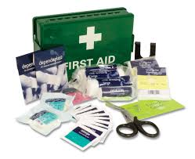
4. Taking Precautions
Seek health advice and request medical clearance 4-6 weeks before travel
Comply with recommended vaccinations, prescribed medication and health measures
Carry a medical kit and understand its use
Be aware of modes of transmission for infectious disease
Keep track of your psychosocial wellbeing and be in good physical shape
UN Core Pre-Deployment Training Materials 2017

Slide 11
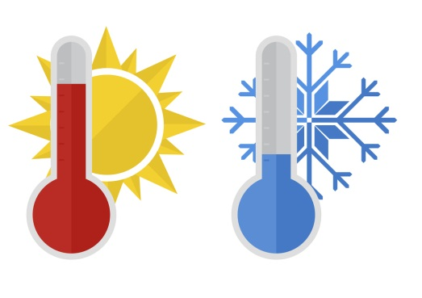
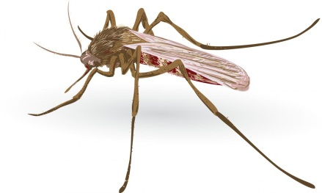
5. Environmental Health Threats & Precautions
Hot and cold climates
Food and drink
Bites and stings
Malaria
UN Core Pre-Deployment Training Materials 2017

Slide 12
Malaria
A common and life-threatening disease in many tropical and subtropical areas
Symptoms: Flu-like, including fever, chills, headache, muscular aching and weakness, vomiting, cough, diarrhoea and abdominal pain
UN Core Pre-Deployment Training Materials 2017

Slide 13
Malaria
Malaria Prophylaxis: Take regularly for the duration of your stay in the malaria area
Even if you are taking malaria prophylaxis, seek medical assistance immediately if you develop a fever
Personal protection against mosquito bites is your first line of defence against malaria – no bite, no malaria
Physical protection: Use such nets and repellents
UN Core Pre-Deployment Training Materials 2017

Slide 14
Summary of Key Messages
Unfamiliar peacekeeping environments and conditions expose you to health threats
Determine the risk to your health
Take precautions before travel to and whilst in mission – seek medical advice, medical clearance, vaccinations
Environmental health threats – hot and cold climates, food and drink, bites and stings, malaria
UN Core Pre-Deployment Training Materials 2017

Slide 15
Questions
UN Core Pre-Deployment Training Materials 2017

Slide 16
Learning Activity
Learning Evaluation
UN Core Pre-Deployment Training Materials 2017

